Slide 1
Programming Studio 1
SQL Continued
Santha Sumanasekara

Slide 2

Overview of the Studio Class
Multi-table SQL statements
Simple JOINs
NATURAL JOIN
LEFT OUTER JOINs
Self joins
Sub-queries
Within WHERE clause
Within FROM clause

Slide 3
SQL JOINS
Many of the common queries will require data from more than one table.
Display names of cities in the world with their countries
Display English-speaking countries
Display other languages spoken in the countries where Swahili is spoken

Slide 4
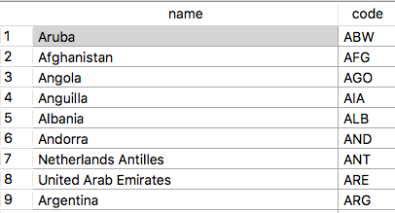
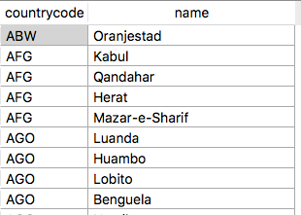
SQL JOINS
Display names of cities in the with their countries

Slide 5
SQL JOIN
C1 and c2 are alias names given to the tables joined here.
Identify which tables contain required data
Identify a common attribute that can be used as the JOIN condition.
SELECT c1.name, c2.name
FROM country c1 JOIN city c2
ON c1.code = c2.countrycode
Join condition using CountryCode.

Slide 6
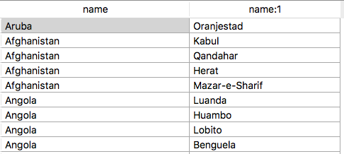
SQL JOINS
Display names of cities in the with their countries

Slide 7
SQL JOINS – Another Example
Display the English-speaking countries
Language details come from CountryLanguage table
Country names are in Country table
Country Code is the common attribute
So (1) Join these two tables and then
(2) filter on “English” language

Slide 8
SQL JOINS – Another Example
SELECT c.name, cl.language
FROM country c JOIN countrylanguage cl
ON c.code = cl.countrycode
WHERE cl.language = 'English’ ;

Slide 9
SQL JOINS – Another way
Tables to be joined are now a comma-separated list.
A quick-and-dirty way of doing a join two tables:
Simply add the join condition to WHERE clause.
SELECT c.name, cl.language
FROM country c, countrylanguage cl
WHERE c.code = cl.countrycode AND
cl.language = 'English’ ;
Join condition is within WHERE clause

Slide 10
Joining more than two tables
Some queries may require data from three or more tables.
In such situations we nest the joins within each other
Say, first join country and city and then the result join with countryLanguage
What are the languages spoken in New Delhi?
This require all three tables joined: Country, CountryLanguage and City.

Slide 11
First join between country and countryLanguage.
Joining more than two tables
SELECT c.name, cy.name, cl.language
FROM (country c JOIN countrylanguage cl
ON c.code = cl.countrycode)
JOIN city cy
on c.code = cy.countrycode
WHERE cy.name = 'New Delhi'
Second join between the result of first join and city

Slide 12
Natural Join
Natural Join is a special case of a join where the two attributes to be used for joining have the same name.
In that case, we do not need to add an ON clause with the join condition.
Replace JOIN with NATURAL JOIN in the FROM clause, with no conditions.
The Join condition is implicit (by their names).
Consider the following example.
In this case, code attribute in City2 is a foreign key referencing code attribute in Country. Make sure no other attributes have common names.
They both have the same name (unlike in our World DB, where the foreign key is called “CountryCode”.
Country (Code, name, continent, region, …)
City2 (ID, CityName, code*, district, CityPopulation)

Slide 13
Natural Join
No explicit condition.
SELECT c1.name, c2.name
FROM country c1 NATURAL JOIN city2 c2;
This is essentially the same as:
SELECT c1.name, c2.name
FROM country c1 JOIN city2 c2
ON c1.code = c2.code;

Slide 14
Left Outer Join
Consider the following query: List all countries in the world, with major cities (if any).
This query must list all countries, regardless of whether there are any major cities.
A simple join will list “only” countries that can match with a city, missing out the countries like Antarctica where there are no major cities.
LEFT OUTER JOIN will be the way to go here.
The left outer join will display all rows from table on the left side of the join regardless of matching rows from the right table.
If there are matches, they will show up, and for the rest, NULLs are displayed.

Slide 15
Left Outer Join
Order of the tables in the FROM clause is important. Use the table that require all rows displayed must be on the left side of the join
SELECT co.name AS "Country Name",
co.code AS “Country Code”,
cy.countrycode AS “Country Code”,
cy.name AS "City Name",
cy. population AS "City Population”
FROM country co LEFT OUTER JOIN city cy
ON co.code = cy.CountryCode
WHERE continent ='Oceania'

Slide 16
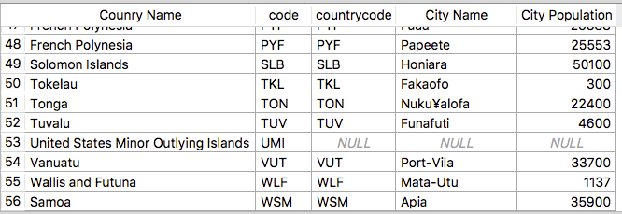
Left Outer Join
There is no country code in City table that match with UMI. So, the corresponding country is padded with null values

Slide 17
Self-Join
The self-join is special kind of join that allows you to join a table to itself using either inner join or left outer join.
You use self-join to create a result set that joins the rows with the other rows within the same table.
E.g. Find the list of employees supervised by Jennifer S. Wallace. (recall the company database we used in Tute 2)
Display other languages spoken in the countries where Swahili is spoken
You will be required to use two alias names to refer each instance of the table (say: employees emp and employees sup

Slide 18
Self-Join: An Example
SELECT sup.fname, sup.minit, sup.lname,
emp.fname, emp.minit, emp.lname
FROM employees emp JOIN employees sup
ON emp.superSSN = sup.SSN
WHERE sup.fname = ‘Jennifer’ AND
sup.minit = ‘S’ AND
sup.lname = ‘Wallace’;
Emplyee table is opened twice, one instance to refer employee superSSN values, and the other to refer SSN values (for supervisors)

Slide 19
Self-Join: Another Example
Display other languages spoken in the countries where Swahili is spoken
This query can be explained as follows:
Open CountryLanguage table once. Scan through the table and collate the country codes that relevant to Swahili language.
Open another instance of the CountryLanguage table, this time filter the rows that match with country codes you got from the previous step.
display the language attribute of the filtered rows.

Slide 20
Self-Join: Another Example
Swahili
BDI
TZA
BDI French
BDI Kirundi
BDI Swahili
TZA Chaga and Pare
TZA Gogo
TZA Ha
TZA Haya
TZA Hehet
TZA Luguru
French
Kirundi
Swahili
Chaga and Pare
Gogo
Ha
Haya
Hehet
Luguru
Input
Country codes that relate to Swahili
All rows filtered on BDI or TZA
Language attribute selected

Slide 21
Self-Join: Another Example
SELECT cl2.countrycode, cl2.language
FROM countrylanguage cl1 JOIN countryLanguage cl2
ON cl1.CountryCode = cl2.countrycode
WHERE cl1.language = 'Swahili';
countryLanguage table is opened twice, one instance to refer country code values related to Swahili, and the other to refer to all reows relevant to those country codes

Slide 22
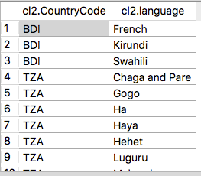

Self-Join: Another Example
CountryLanguage opened
as cl1
CountryLanguage opened
as cl2

Slide 23
Self-Join: Another Example
A small improvement. Remove Swahili from the result set.
SELECT cl2.countrycode, cl2.language
FROM countrylanguage cl1 JOIN countryLanguage cl2
ON cl1.CountryCode = cl2.countrycode
WHERE cl1.language = 'Swahili’ AND
cl2.language <> ‘Swahili’
There is no point display Swahili in the result set, as the original query is to list “other” languages.

Slide 24
Self-Join: Another (harder) Example
Display the countries that share same languages as spoken by South Africans.
This query can be explained as follows:
Open Country and CountryLanguage tables joined together. Scan through the joined table and collate the languages that relevant to South Africa.
Join that result set with another instance of CountryLanguage table. From this second instance, filter all rows relevant to the languages list you obtained in the previous step.
Join this again with another instance of Country table to find the maching country names for the rows you obtained in the previous step.

Slide 25
Self-Join: Another (harder) Example
SELECT c2.name, cl2.language
FROM ((country c1 JOIN countrylanguage cl1
ON c1.code = cl1.countrycode)
JOIN countrylanguage cl2
ON cl1.language = cl2.language)
JOIN country c2
ON cl2.countrycode = c2.code
WHERE c1.name ='South Africa' AND
c2.name <>'South Africa'
It is easy to understand the query by decomposing it into three separate steps.

Slide 26
Self-Join: Another (harder) Example
South Africa ZAF
ZAF Afrikaans
ZAF English
ZAF Ndebele
Afrikaans NAM
Afrikaans ZAF
English ABW
English AIA
English ANT
English AUS
NAM Namibia
ZAF South Africa
ABW Aruba
AIA Anguilla
ANT Antilles
AUS Australia
Input
Languages spoken in SA
Other country codes related those languages
Extract country names related to those codes

Slide 27
Nested Queries sub-selects IN EXISTS

Slide 28
Sub-Selects
The result set of a SELECT statement is no different to a table already in your database
So, you may use a result set from one SQL statement within another SQL statement where a table is accepted.
For example, the table name in the FROM clause can be another SQL statement.
Can be used to simplify the logic: e.g. complex JOIN conditions and WHERE clauses.

Slide 29
Sub-Selects
SELECT <something>
FROM (SELECT <something> FROM <somewhere>)
WHERE <condition>
When you execute this, the inner query is executed first, and the result set is stored temporarily (as a temporary table)
This temp table is used as the source for outer query, which executed next.

Slide 30
Sub-Selects: An Example
Sub-Selects: An Example
List the cities in the English-speaking world.
This can be decomposed into two problems:
Countries in the English-speaking world
Cities in those countries.
The result of the first part itself can be considered as a table (say, ESC)
Then, second problem is to find the cities in ESC.
Write the first part as a sub-select.
If the first part occurs frequently in your queries, you may even be able to reuse that SELECT in many other queries.

Slide 31
Sub-Selects: An Example
SELECT esc.name AS "Country",
cy.name AS "City"
FROM city cy Join <EnglishSpeakingCountries> esc
ON cy.CountryCode = esc.code
Outer Query
This is the table we “generate” using inner query

Slide 32
Sub-Selects: An Example
SELECT esc.name AS "Country",
cy.name AS "City"
FROM city cy Join <EnglishSpeakingCountries> esc
ON cy.CountryCode = esc.code
SELECT co.code, co.name
FROM country co JOIN countryLanguage cl
ON co.code = cl.countryCode
WHERE cl.language = 'English'

Slide 33
Sub-Selects: An Example
SELECT esc.name AS "Country",
cy.name AS "City"
FROM city cy Join
(
SELECT co.code, co.name
FROM country co JOIN countryLanguage cl
ON co.code = cl.countryCode
WHERE cl.language = 'English’
) esc
ON cy.CountryCode = esc.code

Slide 34
In WHERE clause
If the result set of a SELECT statement contain only one attribute, it can be considered as a “set of values or a list” and can be used with IN operator within WHERE clause.
Recall the SQL statement we discussed last week where we used IN operator to list countries in Asia-Pacific region (i.e countries in Asia or Oceania continents).
At that time, we hard-coded the continents list – better than that, we can generate it dynamically, using an inner query.
SELECT name AS “Country Name”
FROM country
WHERE continent IN (AsiaPacificRegion);
AsiaPacificRegion is generated using anoher SQL statement

Slide 35
In WHERE clause: An Example
List the cities in the English-speaking world.
This can again be decomposed into two problems:
Country codes in the English-speaking world
Cities in those countries.
The result of the first part itself can be considered as a list of codes
Then, second problem is to find the cities in those countries.
Write the first part as a sub-query producing a list of codes.
Embed this list within outer query.

Slide 36
In WHERE clause: An Example
SELECT name AS "City"
FROM city
WHERE countryCode IN ( <EnglishSpecking CountryCodes> );
Outer Query
This is the list we “generate” using inner query

Slide 37
In WHERE clause: An Example
SELECT name AS "City"
FROM city
WHERE countryCode IN ( <EnglishSpecking CountryCodes> );
SELECT cl.countrycode
FROM countryLanguage cl
WHERE cl.language = 'English'

Slide 38
In WHERE clause: An Example
SELECT name AS "City"
FROM city
WHERE countryCode IN (
SELECT co.code
FROM country co JOIN
countryLanguage cl
ON co.code = cl.countryCode
WHERE cl.language = 'English'
);

Slide 39
In WHERE clause: An Example
Similar to IN, we can use NOT IN to list cities in the rest of the world.
SELECT name AS "City"
FROM city
WHERE countryCode NOT IN (
SELECT co.code
FROM country co JOIN
countryLanguage cl
ON co.code = cl.countryCode
WHERE cl.language = 'English'
);

Slide 40
With EXISTS (and NOT EXISTS)
The EXISTS operator is different.
It doesn’t compare values vs attributes, etc
What it does is to check if the associated list with it is empty or not empty.
If it is empty, it returns a FALSE value; if the list is not empty, it returns a TRUE value.
This “associated list” can be generated using an inner query.
SELECT name AS “Country Name”
FROM country
WHERE EXISTS AsiaPacificRegion;
Note that there is no attribute to compare against.
AsiaPacificRegion is generated using another SQL statement

Slide 41
With EXISTS clause: An Example
List the cities in the English-speaking world.
This can again be decomposed into three problems:
Pick a city, identify corresponding country code;
Take that country code and cross check with country codes list of English speaking countries.
If it does exist, show the city you picked up.
In this example, the execution starts at the outer query
For each city in outer query, take the country code and feed it into the inner query to check if it is there.
If it does, display the result, or else go to the next city.

Slide 42
With EXISTS clause: An Example
SELECT name AS "City"
FROM city cy
WHERE EXISTS ( <cy.countrycode matched against
EnglishSpecking CountryCodes> );
The inner query will produce a non-empty result if cy.countrycode is an EnglishSpeakingCountry or empty, if it isn’t
Outer Query

Slide 43
With EXISTS clause: An Example
SELECT name AS "City"
FROM city cy
WHERE EXISTS ( <cy.countrycode matched against
EnglishSpecking CountryCodes> );
SELECT *
FROM CountryLanguage cl
WHERE cl.countryCode = cy.CountryCode AND
cl.Language = ‘English’

Slide 44
With EXISTS clause: An Example
SELECT name AS "City"
FROM city cy
WHERE EXISTS (
SELECT *
FROM CountryLanguage cl
WHERE cl.countryCode = cy.CountryCode AND
cl.Language = ‘English’
);
Note that, within the inner query we can refer to attributes and tables of the outer query. This is because the order of execution is different with EXISTS.

Slide 45
More on Nested Queries
There are many other ways we can have nested queries.
We discuss next week a few other nested queries.

